Slide 1
POSIX Threads Programming

Slide 2
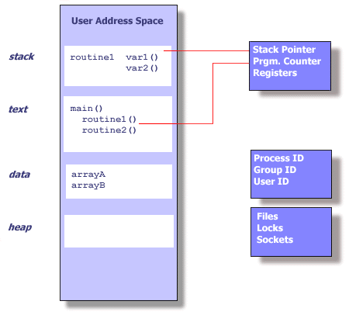
What is a Process ?
Fundamental to almost all operating systems
= program in execution
Seperate address space
program counter, stack pointer, hardware registers

Slide 3
What is a Process ?
Processes contain lots of information:
    Process ID, process group ID, user ID, and group ID
    Environment
    Working Directory
    Program Instructions
    Registers
    Stack
    Heap
    File Descriptors
    Signal Actions
    Shared Libraries
    Inter-process communication tools (such as message queues, pipes, semaphores, or shared memory)‏

Slide 4
What is a Process ?
OS alternate between processes
  run process on CPU
  clock interrupt happens
  save process state
    registers (PC, SP, numeric)
    memory map (address space)
    memory (core image) → possibly swapped to disk
    → process table (PCB)
  continue some other process
Scheduling
Context Switch

Slide 5
Unix process creation: forking
#include <sys/types.h>
#include <unistd.h>
int v = 42;
int main (void)
{
pid_t pid;
if ((pid = fork()) < 0) {
perror("fork");
exit(1);
} else if (pid == 0) {
printf("child %d of parent %d\n", getpid(), getppid());
v++;
printf(“child:%d \n”,v);
}
else {
sleep(10);
printf(“child:%d \n”,v);
}
return 0;
}
Global variable
Parent process forked child process here
Child process executes here
Parent process executes here

Slide 6
fork()‏
Process A
Process B
Global
Variables
Global
Variables
fork()‏
Code
Code
Stack
Stack
Creation of a new process using fork is expensive (time & memory).

Slide 7
Threads
A thread (sometimes called a lightweight process) does not require lots of memory or startup time.
We can see processes as unit of allocation. A process groups resources together.
  Resources, privileges, open files, allocated memory...
We can see threads as unit of execution. They execute on allocated resources.
  PC, SP, registers...
Each process may include many threads
Each thread belongs to one process ( executes inside a process )

Slide 8
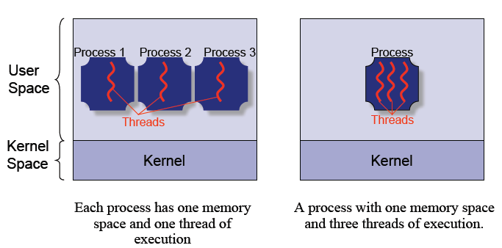
Threads

Slide 9
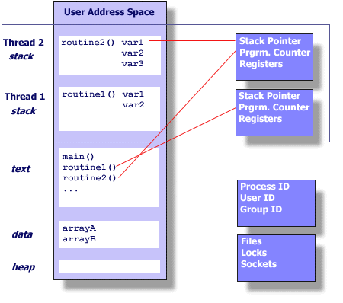
Thread-Specific Resources
Each thread has it’s own hardware execution state:
  Thread ID (integer)‏
  Stack (SP), Registers, Program Counter (PC)
Each thread share following with its process
  Same code and data (address space)
  The same privilege
  The same resources
  Global variables
  Open files
  Signals and signal handlers ...
Threads share the same memory (address space) together with their process but have separate execution context.

Slide 10
Thread Creation
Process A
Thread 1
Global
Variables
thread_create()‏
Code
Process A
Thread 2
Stack
Stack
Each thread has its own stack to store its local variables.

Slide 11
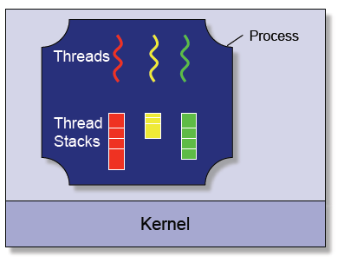
Multiple processes vs Multiple threads
Multiple Threads
  Creation
    Much faster and easy
  Context switching
    Much faster and easy
  Inter-thread Communication
    Much faster and easy
  Protection
    Threads are not protected from each other

Slide 12
What is a POSIX thread?
An IEEE standardized way of using threads on a given system.
Systems that support POSIX threads include:
  Unix
  Linux
  Mac OS X
  Windows (through Cygwin, etc)‏

Slide 13
POSIX Threads API
#include <pthread.h>
C/C++ programs
Linux - you need to link with “-lpthread” library
gcc -lpthread main.c -o main.out
Some Posix Thread API functions:
int pthread_create (pthread_t *tid, pthread_attr_t *attr,void *(start_routine)(void *),void *arg);
void pthread_exit(void *retval);
int pthread_join (pthread_t tid, void **thread_return);
pthread_t pthread_self ();

Slide 14
Creating a New Thread
the thread handle gets stored here
int pthread_create(pthread_t *thread, pthread_attr_t *attr, void *(*start_routine)(void *), void *arg);
returns a 0 if successful
otherwise an errno!
thread attributes,
usually NULL.
the function to begin
executing on this thread.
It must take a void * as an
argument and return a void *.
When the function returns, the
thread exits.
argument given to
the thread function.
usually a pointer
to a struct or an
array

Slide 15
Getting Current Thread Handle
Occasionally, pthread_self useful for a sequence of code to determine which thread is running it.
pthread_t pthread_self ( );
returns thread handle of
the caller thread.

Slide 16
Terminating a Thread
A thread exits when the thread function returns. Alternatively, the thread can call the pthread_exit function.
void pthread_exit(void *retval);
this must point to data
that exists after the thread
terminates!

Slide 17
Cast (void *) to integer (since void * is a pointer and pointer is nothing other than 32 bit integer value.)
#include <pthread.h>
#include <stdio.h>
#include <stdlib.h>
#define NUM_THREADS 5
void *HelloWorld(void *threadid)
{
int tid;
tid = (int)threadid;
printf("Hello World! It's me, thread #%d!\n", tid);
pthread_exit(0);
}
int main(int argc, char *argv[])
{
pthread_t threads[NUM_THREADS];
int i;
for(i=0;i<NUM_THREADS;i++)
{
pthread_create(&threads[i], 0, HelloWorld, (void *)i);
}
pthread_exit(0);
return 0;
}
Start of thread execution
Thread handles
Handle of the created thread
Address of start function
Argument to the function

Slide 18
#include <pthread.h>
#include <stdio.h>
#include <stdlib.h>
#define NUM_THREADS 8
char *messages[NUM_THREADS];
void *HelloWorld(void *threadid)
{
int id;
sleep(1);
id = (int) threadid;
printf("Thread %d: %s\n", id, messages[id]);
pthread_exit(0);
}
int main(int argc, char *argv[])
{
pthread_t threads[NUM_THREADS];
int i;
messages[0] = "English: Hello World!";
messages[1] = "French: Bonjour, le monde!";
messages[2] = "Spanish: Hola al mundo";
messages[3] = "Klingon: Nuq neH!";
messages[4] = "German: Guten Tag, Welt!";
messages[5] = "Russian: Zdravstvytye, mir!";
messages[6] = "Japan: Sekai e konnichiwa!";
messages[7] = "Latin: Orbis, te saluto!";
for(i=0;i<NUM_THREADS;i++)
{
pthread_create(&threads[i], NULL,
HelloWorld, (void *)i);
}
pthread_exit(0);
return 0;
}
Fill global data
Create threads
Global data
Access and print global data

Slide 19
Passing Data to Threads
int pthread_create(pthread_t *thread, pthread_attr_t *attr, void *(*start_routine)(void *), void *arg);
The thread argument is of type void* . This allows us to pass a lot of data to a thread by passing a pointer to a struct or an array of data with casting it to the void * pointer.
struct data_t
{
int thread_id;
int x;
};
...
struct data_t thread_data;
thread_data.thread_id = 0;
thread_data.x = 1;
...
pthread_create(th,NULL,start, (void *) &thread_data);

Slide 20
#include <pthread.h>
#include <stdio.h>
#include <stdlib.h>
#define NUM_THREADS 8
char *messages[NUM_THREADS];
struct thread_data
{
int thread_id;
int sum;
char *message;
};
struct thread_data thread_data_array[NUM_THREADS];
Structure for passing data to the thread
Global array that holds arguments to the threads

Slide 21
int main(int argc, char *argv[])
{
pthread_t threads[NUM_THREADS];
int i,sum= 0;
messages[0] = "English: Hello World!";
messages[1] = "French: Bonjour, le monde!";
messages[2] = "Spanish: Hola al mundo";
messages[3] = "Klingon: Nuq neH!";
messages[4] = "German: Guten Tag, Welt!";
messages[5] = "Russian: Zdravstvytye, mir!";
messages[6] = "Japan: Sekai e konnichiwa!";
messages[7] = "Latin: Orbis, te saluto!";
for(i=0;i<NUM_THREADS;i++)
{
sum = sum + i;
thread_data_array[i].thread_id = i;
thread_data_array[i].sum = sum;
thread_data_array[i].message = messages[i];
pthread_create(&threads[i], NULL, HelloWorld, (void *)&thread_data_array[i]);
}
pthread_exit(0);
}
Fill data structure to pass to the thread function ( fill ith element of the global array)
Pass the ith element of the global array to the thread start function

Slide 22
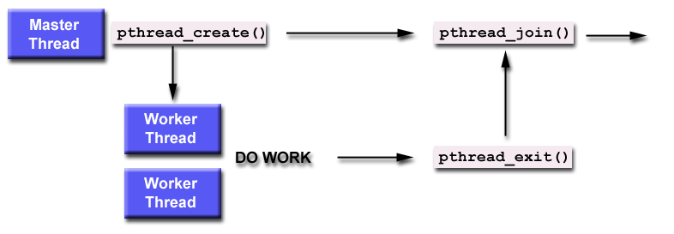
Waiting for a Thread
int pthread_join (pthread_t tid, void **thread_return);
0 on success
or error code.
pointer to the return value.
NULL if there is nothing to return.
the thread to wait for

Slide 23
#include <pthread.h>
#include <stdio.h>
#include <stdlib.h>
#define NUM_THREADS 3
void *BusyWork(void *null)
{
int i;
double result=0.0;
for (i=0; i<1000000; i++)
{
result = result + (double)random();
}
printf("Thread result = %e\n",result);
pthread_exit(0);
}
int main(int argc, char *argv[])
{
pthread_t thread[NUM_THREADS];
pthread_attr_t attr;
int i;
for(i=0;i<NUM_THREADS;i++)
{
pthread_create(&thread[i],0, BusyWork, NULL);
}
for(i=0;i<NUM_THREADS;i++)
{
pthread_join(thread[i],0);
}
printf("Completed join with thread %d\n",i);
pthread_exit(0);
}
Create threads
Main thread is waiting other threads to finish
All created threads finished here

Slide 24
Shared Global Variables
int counter=0;
....
void *start(void *arg) {
counter++;
printf("Thread %u is number %d\n", pthread_self(),counter);
}
main() {
int i; pthread_t tid;
for (i=0;i<10;i++)‏
pthread_create(&tid,NULL,start,NULL);
}
Threads share all global variables
Sharing global variables is dangerous - two threads may attempt to modify the same variable at the same time.
Threads must be synchronized to avoid problems on shared global variables.

Slide 25
Mutex
A synchronization variable that is used to synchronize access on shared memory regions. It has 2 blocking operations on it:
  Lock(mutex): an atomic operation that locks mutex. If the mutex is already locked, it blocks the caller thread.
  Unlock(mutex): an atomic operation that unlocks mutex. If there are any waiting threads, this functions unblocks one of them.
Permit only one thread to execute a section of the code that access shared variables (shared memory regions : critical sections)
The general idea is to lock it before accessing global variables and to unlock as soon as we are done.

Slide 26
Mutex
A1 statement
A2 mutex.wait()
A3 wolski.balance =
wolski balance - 200
A4 mutex.signal()
A5 statement
B1 statement
B2 mutex.wait()
B3 wolski.balance =
wolski balance - 200
B4 mutex.signal()
B5 statement
balance = 1000
mutex = 1

Slide 27
Mutex
A1 statement
A2 mutex.wait()
A3 wolski.balance =
wolski balance - 200
A4 mutex.signal()
A5 statement
B1 statement
B2 mutex.wait()
B3 wolski.balance =
wolski balance - 200
B4 mutex.signal()
B5 statement
balance = 1000
mutex = 1

Slide 28
Mutex
A1 statement
A2 mutex.wait()
A3 wolski.balance =
wolski balance - 200
A4 mutex.signal()
A5 statement
B1 statement
B2 mutex.wait()
B3 wolski.balance =
wolski balance - 200
B4 mutex.signal()
B5 statement
balance = 1000
mutex = 0

Slide 29
Mutex
A1 statement
A2 mutex.wait()
A3 wolski.balance =
wolski balance - 200
A4 mutex.signal()
A5 statement
B1 statement
B2 mutex.wait()
B3 wolski.balance =
wolski balance - 200
B4 mutex.signal()
B5 statement
balance = 800
mutex = 0

Slide 30
Mutex
A1 statement
A2 mutex.wait()
A3 wolski.balance =
wolski balance - 200
A4 mutex.signal()
A5 statement
B1 statement
B2 mutex.wait()
B3 wolski.balance =
wolski balance - 200
B4 mutex.signal()
B5 statement
balance = 800
mutex = 0

Slide 31
Mutex
A1 statement
A2 mutex.wait()
A3 wolski.balance =
wolski balance - 200
A4 mutex.signal()
A5 statement
B1 statement
B2 mutex.wait()
B3 wolski.balance =
wolski balance - 200
B4 mutex.signal()
B5 statement
balance = 800
mutex = -1

Slide 32
Mutex
A1 statement
A2 mutex.wait()
A3 wolski.balance =
wolski balance - 200
A4 mutex.signal()
A5 statement
B1 statement
B2 mutex.wait()
B3 wolski.balance =
wolski balance - 200
B4 mutex.signal()
B5 statement
balance = 800
mutex = -1

Slide 33
Mutex
A1 statement
A2 mutex.wait()
A3 wolski.balance =
wolski balance - 200
A4 mutex.signal()
A5 statement
B1 statement
B2 mutex.wait()
B3 wolski.balance =
wolski balance - 200
B4 mutex.signal()
B5 statement
balance = 800
mutex = 0

Slide 34
Mutex
A1 statement
A2 mutex.wait()
A3 wolski.balance =
wolski balance - 200
A4 mutex.signal()
A5 statement
B1 statement
B2 mutex.wait()
B3 wolski.balance =
wolski balance - 200
B4 mutex.signal()
B5 statement
balance = 800
mutex = 0

Slide 35
Mutex
A1 statement
A2 mutex.wait()
A3 wolski.balance =
wolski balance - 200
A4 mutex.signal()
A5 statement
B1 statement
B2 mutex.wait()
B3 wolski.balance =
wolski balance - 200
B4 mutex.signal()
B5 statement
balance = 800
mutex = 0

Slide 36
Mutex
A1 statement
A2 mutex.wait()
A3 wolski.balance =
wolski balance - 200
A4 mutex.signal()
A5 statement
B1 statement
B2 mutex.wait()
B3 wolski.balance =
wolski balance - 200
B4 mutex.signal()
B5 statement
balance = 600
mutex = 0

Slide 37
Mutex
A1 statement
A2 mutex.wait()
A3 wolski.balance =
wolski balance - 200
A4 mutex.signal()
A5 statement
B1 statement
B2 mutex.wait()
B3 wolski.balance =
wolski balance - 200
B4 mutex.signal()
B5 statement
balance = 600
mutex = 1

Slide 38
Mutex
A1 statement
A2 mutex.wait()
A3 wolski.balance =
wolski balance - 200
A4 mutex.signal()
A5 statement
B1 statement
B2 mutex.wait()
B3 wolski.balance =
wolski balance - 200
B4 mutex.signal()
B5 statement
balance = 600
mutex = 1

Slide 39
Pthread Mutex API
pthreads includes support for Mutual Exclusion primitives that can be used to synchronize threads.
Posix Mutex API functions:
int pthread_mutex_init(pthread_mutex_t *mutex, const pthread_mutexattr_t *mutexattr);
int pthread_mutex_lock(pthread_mutex_t *mutex);
int pthread_mutex_unlock(pthread_mutex_t *mutex);
int pthread_mutex_destroy(pthread_mutex_t *mutex);

Slide 40
int main()
{
pthread_t idA, idB;
if (pthread_mutex_init(&mutex, NULL) < 0)
{
perror("pthread_mutex_init");
exit(1);
}
if (pthread_create(&idA, NULL, MyThread, (void *)"A") != 0)
{
perror("pthread_create");
exit(1);
}
if (pthread_create(&idB, NULL, MyThread, (void *)"B") != 0)
{
perror("pthread_create");
exit(1);
}
pthread_join(idA, NULL);
pthread_join(idB, NULL);
pthread_mutex_destroy(&mutex);
}
Global mutex variable that will be used for synchronization
Initialize mutex before using it
#include <pthread.h>
#include <stdio.h>
#include <stdlib.h>
pthread_mutex_t mutex;
int x = 0;
void *MyThread(void *arg)
{
char *sbName;
sbName = (char *)arg
pthread_mutex_lock(&mutex);
  x = x + 1;
pthread_mutex_unlock(&mutex);
printf("X = %d in Thread %s\n", x, sbName);
}
Shared global variable
Lock mutex before changing global variable. This will block the caller thread if the mutex is locked.
Unlock mutex after changing global variable
Destroy mutex after using it

Slide 41
Semaphores
A synchronization variable that takes on positive integer values. It has 2 blocking operations on it:
  Wait(semaphore): an atomic operation that waits for semaphore to become positive, then decrements it by 1. (blocks caller if semaphore is negative)
  Signal(semaphore): an atomic operation that increments semaphore by 1. (if the value of the semafore is negative, this function unblocks one of the waiting threads)
Permit a limited number of threads to execute a section of the code
Similar to mutexes
Generally used for signalling existence of an event or action

Slide 42
Signalling
.
.
.
A1 statement
A2 sem.signal()
.
.
.
.
.
.
B1 sem.wait()
B2 statement
.
.
.
sem = 0

Slide 43
Signalling
.
.
.
A1 statement
A2 sem.signal()
.
.
.
.
.
.
B1 sem.wait()
B2 statement
.
.
.
sem = 0

Slide 44
Signalling
.
.
.
A1 statement
A2 sem.signal()
.
.
.
.
.
.
B1 sem.wait()
B2 statement
.
.
.
sem = 0

Slide 45
Signalling
.
.
.
A1 statement
A2 sem.signal()
.
.
.
.
.
.
B1 sem.wait()
B2 statement
.
.
.
sem = 0

Slide 46
Signalling
.
.
.
A1 statement
A2 sem.signal()
.
.
.
.
.
.
B1 sem.wait()
B2 statement
.
.
.
sem = 0

Slide 47
Signalling
.
.
.
A1 statement
A2 sem.signal()
.
.
.
.
.
.
B1 sem.wait()
B2 statement
.
.
.
sem = -1

Slide 48
Signalling
.
.
.
A1 statement
A2 sem.signal()
.
.
.
.
.
.
B1 sem.wait()
B2 statement
.
.
.
sem = -1

Slide 49
Signalling
.
.
.
A1 statement
A2 sem.signal()
.
.
.
.
.
.
B1 sem.wait()
B2 statement
.
.
.
sem = -1

Slide 50
Signalling
.
.
.
A1 statement
A2 sem.signal()
.
.
.
.
.
.
B1 sem.wait()
B2 statement
.
.
.
sem = 0

Slide 51
Signalling
.
.
.
A1 statement
A2 sem.signal()
.
.
.
.
.
.
B1 sem.wait()
B2 statement
.
.
.
sem = 0

Slide 52
Signalling
.
.
.
A1 statement
A2 sem.signal()
.
.
.
.
.
.
B1 sem.wait()
B2 statement
.
.
.
sem = 0

Slide 53
Signalling
.
.
.
A1 statement
A2 sem.signal()
.
.
.
.
.
.
B1 sem.wait()
B2 statement
.
.
.
sem = 0

Slide 54
Signalling
.
.
.
A1 statement
A2 sem.signal()
.
.
.
.
.
.
B1 sem.wait()
B2 statement
.
.
.
sem = 0

Slide 55
Signalling
.
.
.
A1 statement
A2 sem.signal()
.
.
.
.
.
.
B1 sem.wait()
B2 statement
.
.
.
sem = 0

Slide 56
Signalling
.
.
.
A1 statement
A2 sem.signal()
.
.
.
.
.
.
B1 sem.wait()
B2 statement
.
.
.
sem = 0

Slide 57
Signalling
.
.
.
A1 statement
A2 sem.signal()
.
.
.
.
.
.
B1 sem.wait()
B2 statement
.
.
.
sem = 0

Slide 58
#include < semaphore.h>
C/C++ programs
Semaphore API functions:
int sem_init(sem_t *sem, int pshared, unsigned int value);
Semaphore object
Generally 0
Gives an initial value to the semaphore
int sem_post(sem_t *sem);
atomically increases the value of a semaphore by 1
int sem_wait(sem_t *sem);
atomically decreases the value of a semaphore by 1
int sem_destroy(sem_t *sem);
Frees resources allocated for semaphore

Slide 59
#include <pthread.h>
#include <semaphore.h>
void *thread_function( void *arg );
sem_t semaphore;
int main()‏
{
int tmp;
tmp = sem_init( &semaphore, 0, 0 );
pthread_create( &thread[i], NULL, thread_function, NULL );
while ( still_has_something_to_do() )‏
{
sem_post( &semaphore );
}
pthread_join( thread[i], NULL );
sem_destroy( &semaphore );
return 0;
}
Global semaphore variable
void *thread_function( void *arg )‏
{
sem_wait( &semaphore );
...
pthread_exit( NULL );
}
initialize semaphore
wait semaphore
signal semaphore
destroy semaphore

Slide 60
#include <stdio.h> /* Input/Output */
#include <stdlib.h> /* General Utilities */
#include <pthread.h> /* POSIX Threads */
#include <semaphore.h> /* Semaphore */
#define BUFFER_SIZE 5
int headPos = BUFFER_SIZE - 1;
int endPos = 0;
int Buffer[BUFFER_SIZE];
sem_t producerSem;
sem_t consumerSem;
pthread_mutex_t mutex;
İnit mutex that will be used to access shared Buffer
int main()
{
int i[2];
pthread_t thread_a;
pthread_t thread_b;
pthread_mutex_init(&mutex, NULL);
pthread_create (&thread_a, 0, producer, (void *)0);
pthread_create (&thread_b, 0, consumer, (void *)0);
pthread_join(thread_a, NULL);
pthread_join(thread_b, NULL);
/* exit */
exit(0);
}
Producer semaphore used for the notification from consumer thread
Global buffer to store produced values
Consumer semaphore used for the notification from producer thread
Mutex that will be used to access shared Buffer

Slide 61
void *producer(void *arg)
{
int itemCount = 10;
sem_init(&producerSem, 0,1);
while(itemCount)
{
sem_wait(&producerSem);
pthread_mutex_lock(&mutex);
Buffer[endPos] = 1;
printf("Producer Thread : Buffer[%d] = 1 \n",endPos);
endPos = (endPos + 1) % BUFFER_SIZE;
itemCount--;
pthread_mutex_unlock(&mutex);
sem_post(&consumerSem);
}
pthread_exit(0);
return 0;
}
İnit semaphore with 1
Wait notification from consumer thread
Enter critical section
Access shared memory and produce value
Exit critical section
Notify consumer thread

Slide 62
void *consumer(void *arg)
{
int itemCount = 10;
sem_init(&producerSem, 0,0);
while(itemCount)
{
sem_wait(&consumerSem);
pthread_mutex_lock(&mutex);
Buffer[headPos] = 0;
printf("Consumer Thread : Buffer[%d] = 0 \n",headPos);
headPos = (headPos + 1) % BUFFER_SIZE;
itemCount--;
pthread_mutex_unlock(&mutex);
sem_post(&producerSem);
}
pthread_exit(0);
return 0;
}
İnit semaphore with 0
Wait notification from consumer thread
Enter critical section
Access shared memory and consume value
Exit critical section
Notify producer thread

Slide 63
References
https://computing.llnl.gov/tutorials/pthreads/
http://debryro.uvsc.edu/3060/slides/
http://students.cs.byu.edu/~cs345ta/CS345-09%20F2007/presentations/LinuxProcessesAndThreads.ppt

